Slide 1
Reporting on Hospital-Acquired Conditions
Ronald Campbell
CHCF Center for Health Reporting
At USC ANNENBERG

Slide 2
Relax
My presentation, with data you can download, is here:
roncampbell.github.io/Hospital-Infections/

Slide 3
The big picture
One of every 25 hospital patients gets a hospital-acquired condition (HAC).
In 2007 CMS stopped paying hospitals for treating certain HACs.
This year CMS began imposing fines and posted HAC data for virtually every hospital nationwide.

Slide 4
CMS data – where hospitals lose money
Hospital Compare
Hospital-Acquired Condition Reduction Program
Worst quartile lose 1% off Medicare for:
Catheter-Associated Urinary Tract Infections
Central Line-Associated Bloodstream Infections
AHRQ Patient Safety Indicator 90 (eight measures, mostly post-operative)
Overall score on 0 (best) to 10 (worst) scale; fines begin when scores equal or exceed 7.

Slide 5
Bottom line
In Fiscal Year 2015:
724 hospitals nationwide penalized
$373 million in reduced payments

Slide 6
CMS data – no fines
Hospital Compare
Healthcare-Associated Infections
Includes CLABSI, CAUTI and more:
Surgical Site Infections of the abdomen and colon
MRSA
Clostridium difficile (C. diff.)
With national comparisons and 0-to-10 scores.

Slide 7
Old data, old excuse
Most of the data was collected in 2012 and 2013.
Ventura County Medical Center score: 9.675 – second-highest in state (and far larger than the top-ranked hospital)
“These 2-year-old scores are not where we are now.”

Slide 8
Who is fined most?
In California, safety net hospitals are hit with HAC fines significantly more often than other hospitals.
Safety net Other
Count 74 223
Median score 6.275 5.425
% fined 33.8% 22.5%

Slide 9
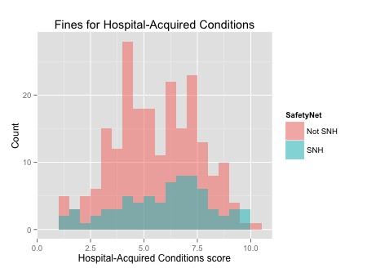
The big picture

Slide 10
Is the net torn?
Potential explanations for heavier HAC fines for safety net hospitals:
Chance – it’s a blip or a California thing.
Safety nets do worse on all the Obamacare metrics, including readmissions and value-based purchasing. Why should HACs be different?
HAC scores are based largely on billing records; incorrect coding of bills could explain the problem.
Safety net patients don’t see doctors frequently; they are sicker and more prone to infection than patients at other hospitals.

Slide 11
Other sources
CDC: Has a site devoted to the subject; publishes an extensive annual report with state-by-state statistics.
California Department of Public Health: Posts hospital statistics for CLABSI, C. diff., MRSA, several SSIs and VRE in its Open Data Portal.

Slide 12
One more time
roncampbell.github.io/Hospital-Infections/

